Slide 1
COMPARING NURSING HOMES
Based on data from January

Slide 2
resource information
This information was obtained from Kaggle.com and Medicare.gov (Nursing Home Compare)
DEFINITIONS
Fines – can be imposed once per citation or each day until the nursing home corrects the citation
Payment Denials – the government stops Medicare and/or Medicaid payments to the nursing home for new residents until the nursing home corrects the citation
Deficiencies – inadequate staff to patient ratio, food storage and preparation issues, failure to protect residents from abuse and neglect, improper medication management, lack of or insufficient emergency preparedness, and failure to pass fire safety inspections

Slide 3
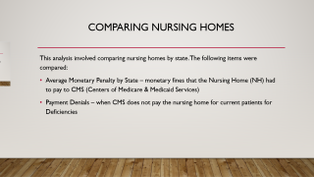
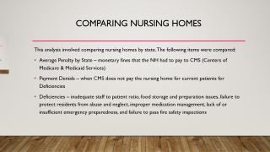
Comparing nursing homes
This analysis involved comparing nursing homes by state. The following items were compared:
Average Monetary Penalty by State – monetary fines that the Nursing Home (NH) had to pay to CMS (Centers of Medicare & Medicaid Services)
Payment Denials – when CMS does not pay the nursing home for current patients for Deficiencies

Slide 4
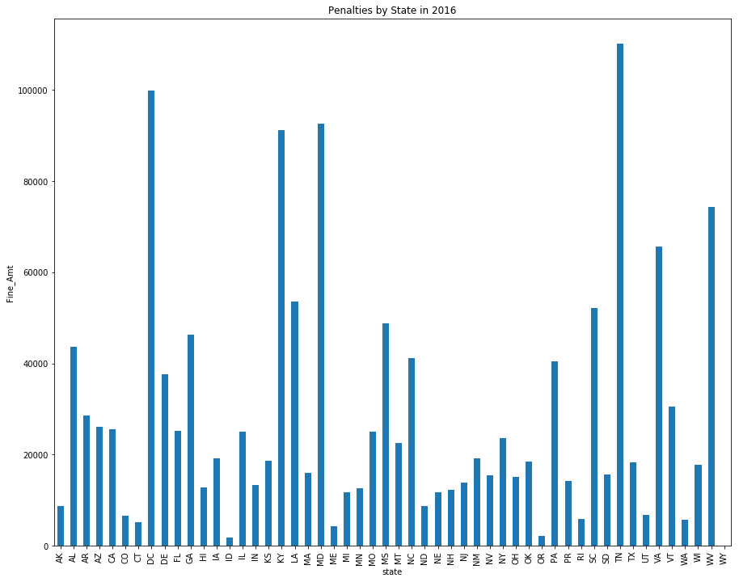

Slide 5
BAR CHART COMPARISON
TN and DC had the highest amount of fines that exceeded $100K
WY, ID and OR had the lowest amount of fines that were less than $2500
Virginia averaged approx. $66K in fines
The national average is approx. $25K in fines

Slide 6
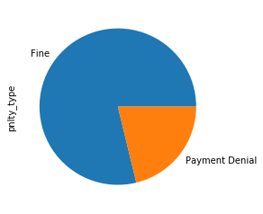
Pie chart analysis
This chart illustrates that there were fewer payment denials in 2016 than there were fines.

Slide 7
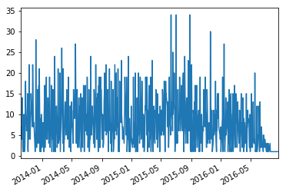
Line graph analysis

Slide 8
Line graph analysis Jan 2014 – may 2016
This graph illustrates that penalties spiked between 5/15 and 9/15.
Penalties decreased between 1/16 and 5/15.
Further data analysis would need to be performed to provide explanations of the increases and decreases.

Slide 9
summary
In conclusion, nursing homes in states with higher rates of penalties and payment denials demonstrate a lower quality of care – not advisable to place a loved one there!
Nursing homes in states with lower penalties and payment denials indicate a higher quality of care – these are highly desirable placements.
This information is not captured in this data analysis: Visit and check on your loved one often and advocate – they will receive better care regardless of how the Nursing Home is ranked.

